Slide 1

XML Parsing Using SQL
Programmers.io Confidential and Proprietary

Slide 2
XML Parsing Using SQL
Topics covered
Basic Keywords:
Parsing of XML using SQL
XML Data Type
XMLTABLE Function
XMLPARSE Function
PATH Clause
To Build XML using SQL
SQLTYPE(XML_CLOB_File)
XMLSerialize Function
XMLElement Function
XMLAttributes Function
XMLAlgg Function
Programmers.io Confidential and Proprietary

Slide 3
XML DATATYPE
XML data type is used to define columns of a table and store XML values.
The xml data type is a built-in data type in SQL Server and is somewhat similar to other built-in types such as int and varchar. As with other built-in types, you can use the xml data type as a column type when you create a table as a variable type, a parameter type, a function-return type, or in CAST and CONVERT.
You can use this native data type to store well-formed XML documents in their native hierarchical format in the database alongside other relational data.
Programmers.io Confidential and Proprietary

Slide 4
XMLTABLE Function
The XMLTABLE SQL table function returns a table from the evaluation of XQuery expressions.
XQuery expressions normally return values as a sequence, however, use the XMLTABLE function to execute XQuery expressions and return values as a table instead
The table that is returned can contain columns of any SQL data type, including XML.
The XMLTABLE function converts one or more XML documents into rows and columns.
Programmers.io Confidential and Proprietary

Slide 5

XMLPARSE Function
The XMLPARSE function parses the argument as an XML document and returns an XML value.
The XMLParse() function is not intended for parsing external data and loading it into XML columns.
The resulting XML data type is stored as a varchar or nvarchar value that has a maximum size of 64,000 bytes.
Programmers.io Confidential and Proprietary

Slide 6
PATH Clause
The optional PATH clause specifies that the portion of the
XQuery result that is addressed by XQuery expression string
is to be used as the column content.
You can use different PATH clauses to split the XQuery result
into different virtual-table columns.
XMLTable(... COLUMNS xyz PATH 'XYZ’)
Programmers.io Confidential and Proprietary

Slide 7
SQLTYPE(XML_CLOB_File)
SQLTYPE(XML_CLOB_File) is a XML file reference variable in ILE RPG applications that uses SQL.
XML file reference example in RPG free:
DCL-S XMLFileName SQLTYPE(XML_CLOB_File);
The variable definition is SQL data type and if we give a size e.g. SQLTYPE(CLOB: Length), it will be limited by RPG's limit for a variable, 16MB, but if we do not give any size then we can write up to 2GB of data directly to the file in the IFS.
The SQL precompiler translate the definition into a data structure.
These are the subfields as generated from a CLOB_FILE SQL data type.
XMLFileName_NAME: Name of the IFS file, including the full path.
XMLFileName_NL: Length of the IFS file's name.
XMLFileName_FO: File operation.
XMLFileName_DL: Not used.
Programmers.io Confidential and Proprietary

Slide 8
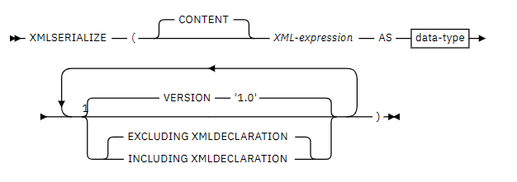
XMLSERIALIZE Function
The XMLSERIALIZE function returns a serialized XML value of the specified data type that is generated from the first argument.
Programmers.io Confidential and Proprietary

Slide 9
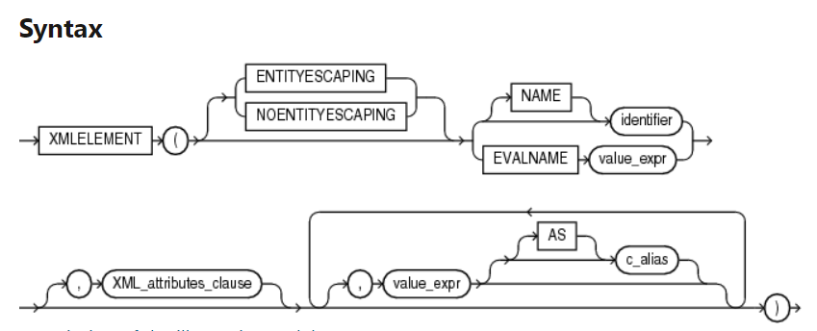
XMLELEMENT Function
The XMLELEMENT function returns an XML value that is an XML element.
The XMLELEMENT function is typically nested to produce an XML document with a nested structure.
Programmers.io Confidential and Proprietary

Slide 10
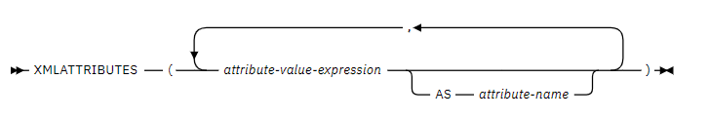
XMLATTRIBUTES Function
The XMLATTRIBUTES function constructs XML attributes from the arguments.
This function can only be used as an argument of the XMLELEMENT function.
The result is an XML sequence containing an XQuery attribute node for each non-null input value.
Programmers.io Confidential and Proprietary

Slide 11
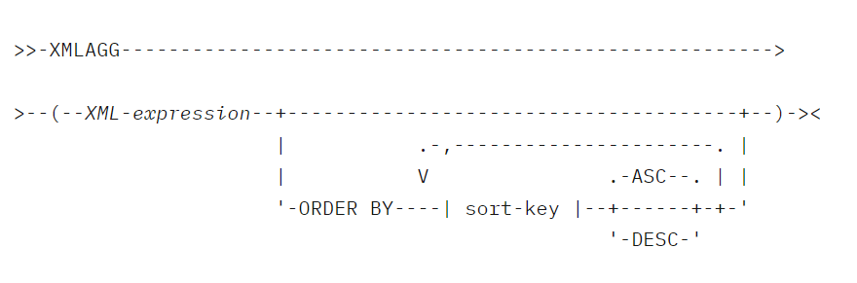
XMLAGG Function
XMLAGG is an aggregate function.
The XMLAGG function returns an XML sequence containing an item for each non-null value in a set of XML values.
Any arguments that return null are dropped from the result.
Programmers.io Confidential and Proprietary

Slide 12
QUESTIONS
Questions !!

